Slide 1




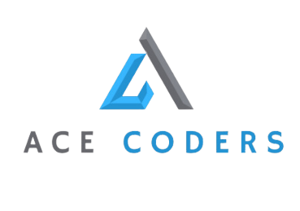
CAMPUS NEX
CAMPUS NEX
Submitted To: Sir Bilal Khalid Dar
Our Team:
Kalsoom Tariq, Haris Sohail, Aimen Safdar

Slide 2
CAMPUS NEX
01
02
03
Intro
Advantages & Constratints
Non-Functional Requirements
- Modules
- Advantages
-Constraints
Performance
Usability
04
05
06
CONTENTS
Design & Architecture
Implementation
Work Divison
Activity Diagram.
Use Case Diagram.
Sequence Diagram.
Class Diagram
Student
Mentor
Iteration 1
Iteration 2
Iteration 3
07
Lesson Learnt
Kalsoom Tariq
Haris Sohail
Aimen Safdar

Slide 3


INTRODUCTION
PART 1.
INTRODUCTION
CAMPUSNEX
ACE CODERS
MODULES

Slide 4

INTRODUCTION
INTRODUCTION
CampusNex is a Desktop Application built by our team ‘AceCoders' to serve as a centralized platform for managing societies operations and enhancing collaboration.
Modules:
Based on time, cost and other resources, we set the scope of our project and shortlisted the following modules for development.
User Authentication
Societies Management and Approval
Dynamic Societies Search
Event Management and Approval
Member Registration
Announcements Management

Slide 5
ADVANTAGES & CONSTRAINTS
PART 2.
ADVANTAGES & CONSTRAINTS
ADVANTAGES
CONSTRATINTS

Slide 6










ADVANTAGES
Centralized Platform for Societies Management
Offers streamlined communication, efficient resource allocation, and cohesive management of user activities across different societies.
Enhanced Collaboration and Coordination
Modules foster better coordination by enabling users to interact, organize events, and share announcements seamlessly, leading to improved engagement and participation.
Agile Development Methodology (SCRUM):
Promotes flexibility, transparency, and ensures that the final product meets stakeholders' evolving needs effectively.
Modular and Scalable Architecture:
The modular architecture, guided by distinct user roles, ensures scalability and flexibility. This modular approach also supports customization based on user roles, ensuring a tailored experience for different user groups.

Slide 7



DISADVANATGES
No External Communication
Communication between group members is unavailable; there is only a functionality of acknowledgment from the Mentor and Society Head.
New User Registration Unavailable.
This application caters for users already registered in their institution e.g. Flex, the institution provides the credentials to login into user’s respective accounts

Slide 8
NON-FUNCTIONAL REQUIREMENTS
NON-FUNCTIONAL
REQUIREMENTS
PART 3.
PERFORMANCE
USABILITY

Slide 9







NON-FUNCTIONAL
REQUIREMENTS
PERFORMANCE
USABILITY .
The system shall respond promptly to user interactions. The average response time for critical user actions will not be more than 1.5 seconds (critical user actions like registering a society, loading dashboard etc).
The system shall be easy to navigate and will have at least 2 helping screens / pop-up windows on each page.

Slide 10
DESIGN & ARCHITECTURE
PART 4
DESIGN & ARCHITECTURE
ACTIVITY DIAGRAM
USE CASE
SEQUENCE DIAGRAM
CLASS DIAGRAM

Slide 11
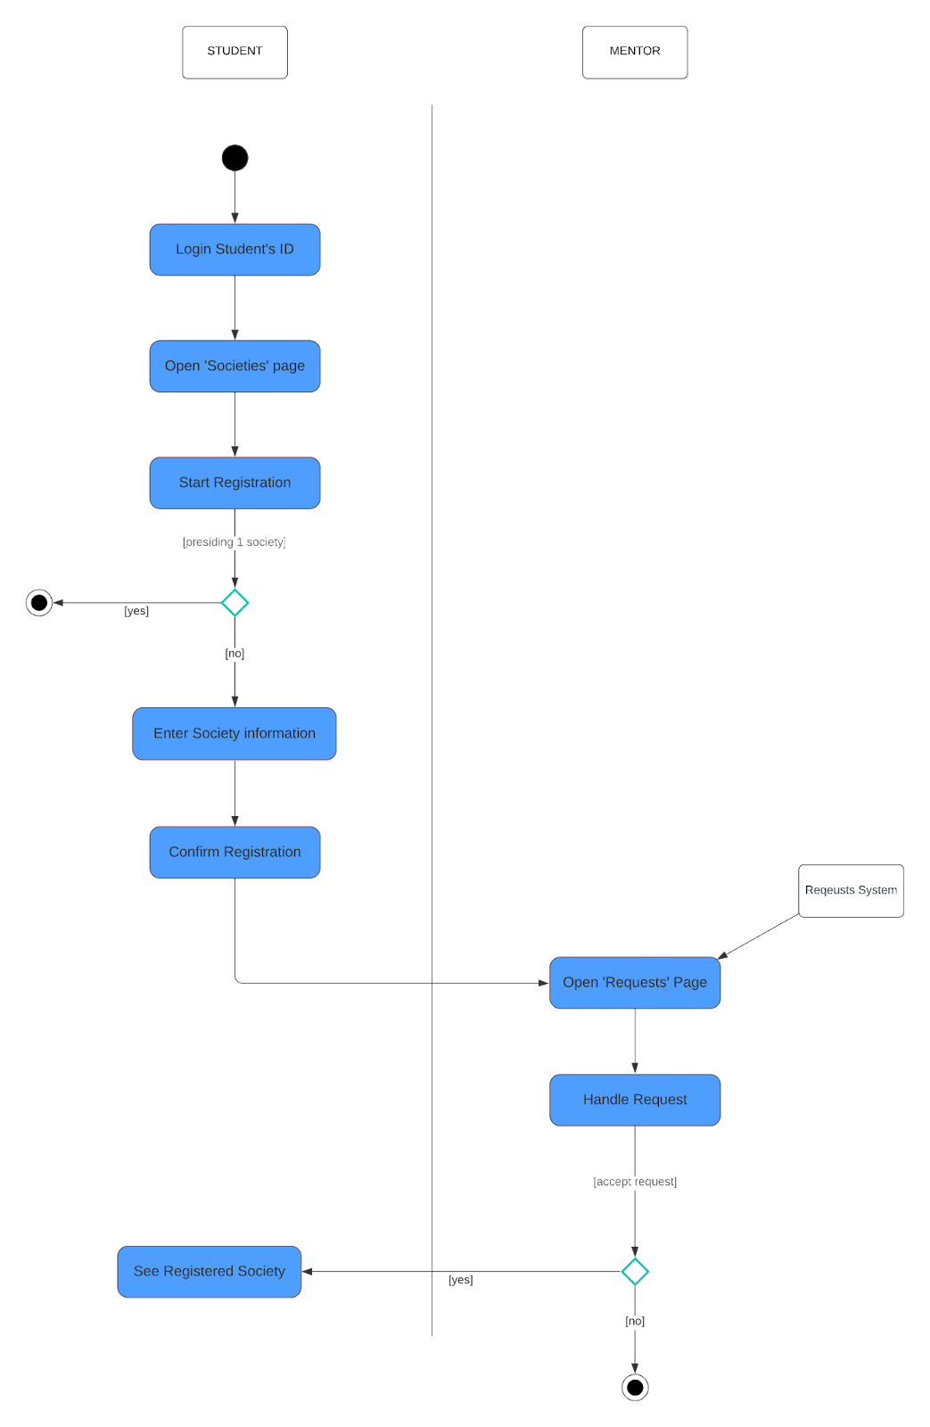
ACTIVITY DIAGRAM:
SOCIETY REGISTRATION
MAIN SOCIETY PAGE FOR MENTOR

Slide 12
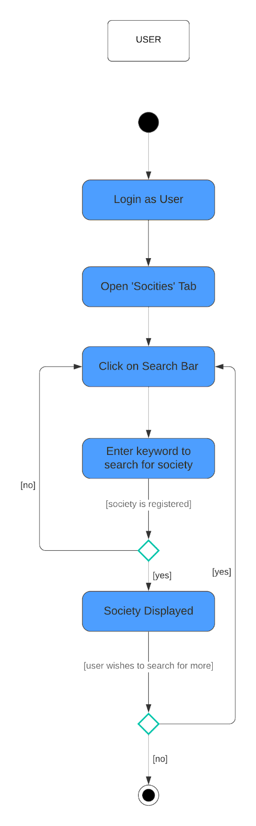
ACTIVITY DIAGRAM:
SEARCH SOCIETY
MAIN SOCIETY PAGE FOR MENTOR

Slide 13
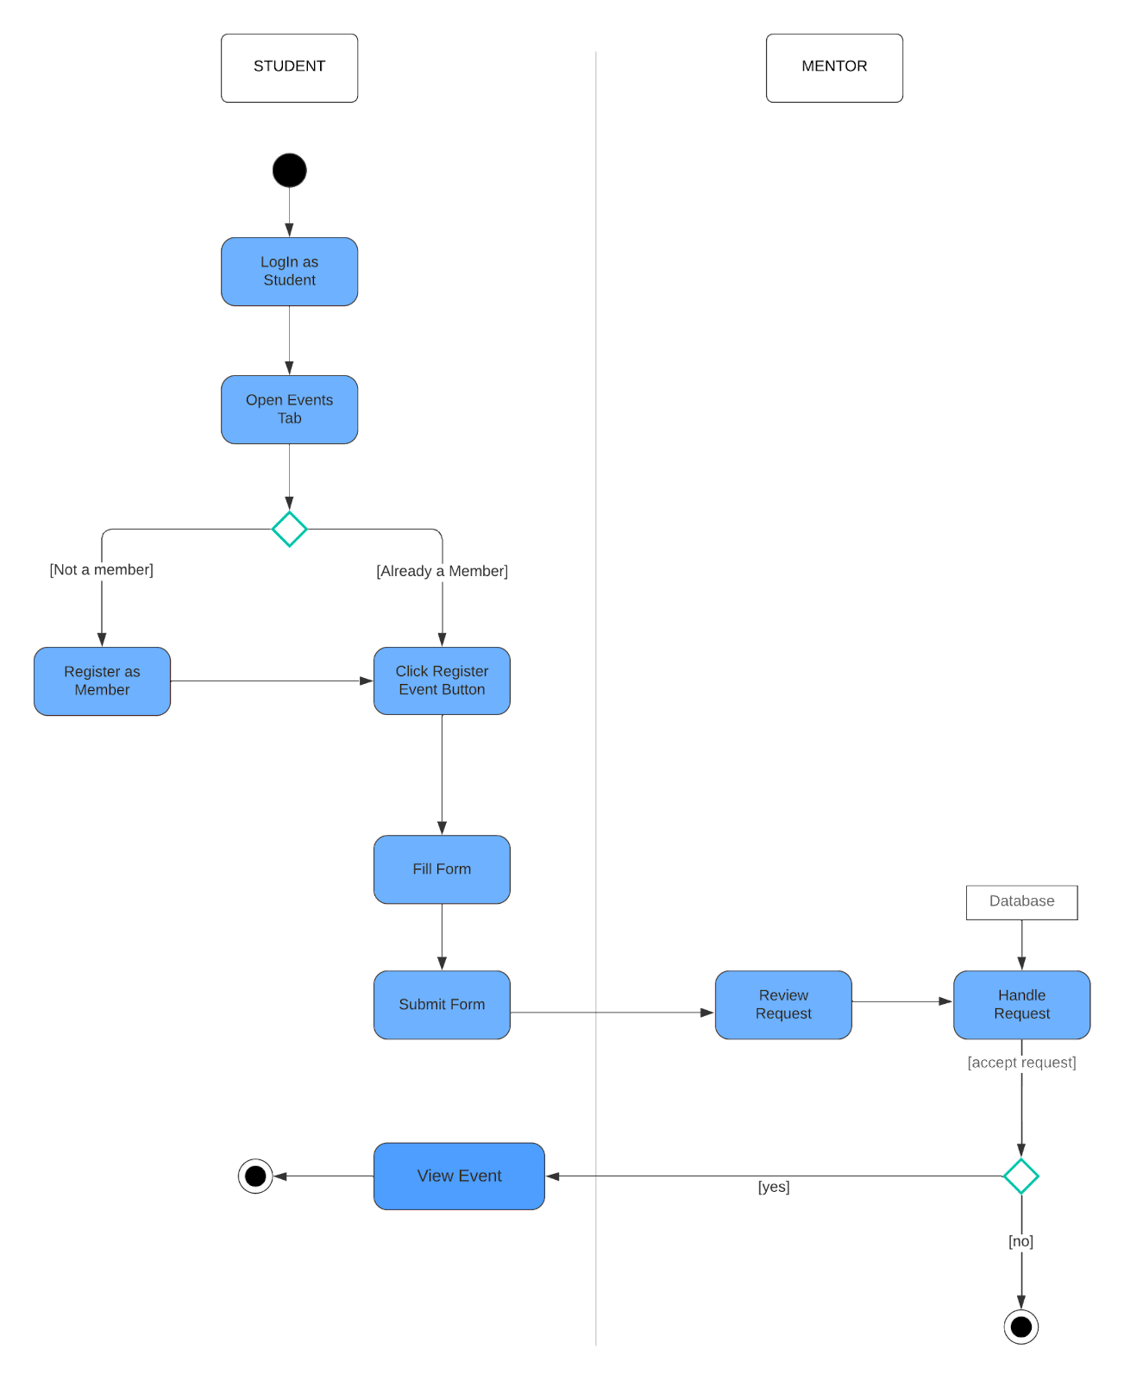
ACTIVITY DIAGRAM:
EVENT REGISTRATION
MAIN SOCIETY PAGE FOR MENTOR

Slide 14
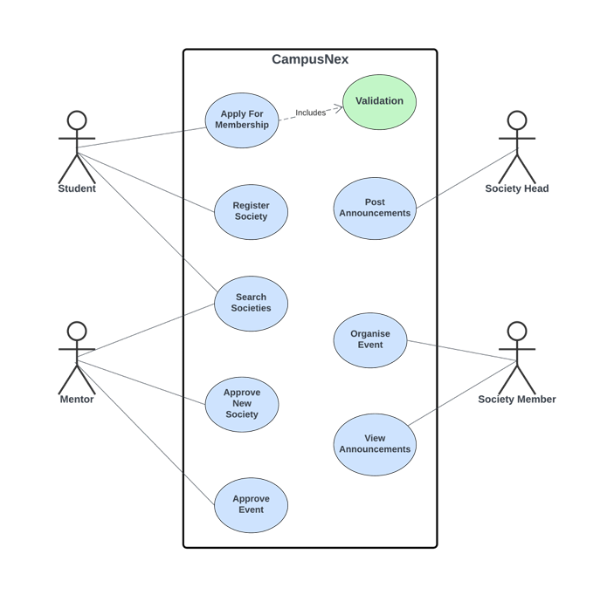
DESIGN:
USE CASE
MAIN SOCIETY PAGE FOR MENTOR

Slide 15
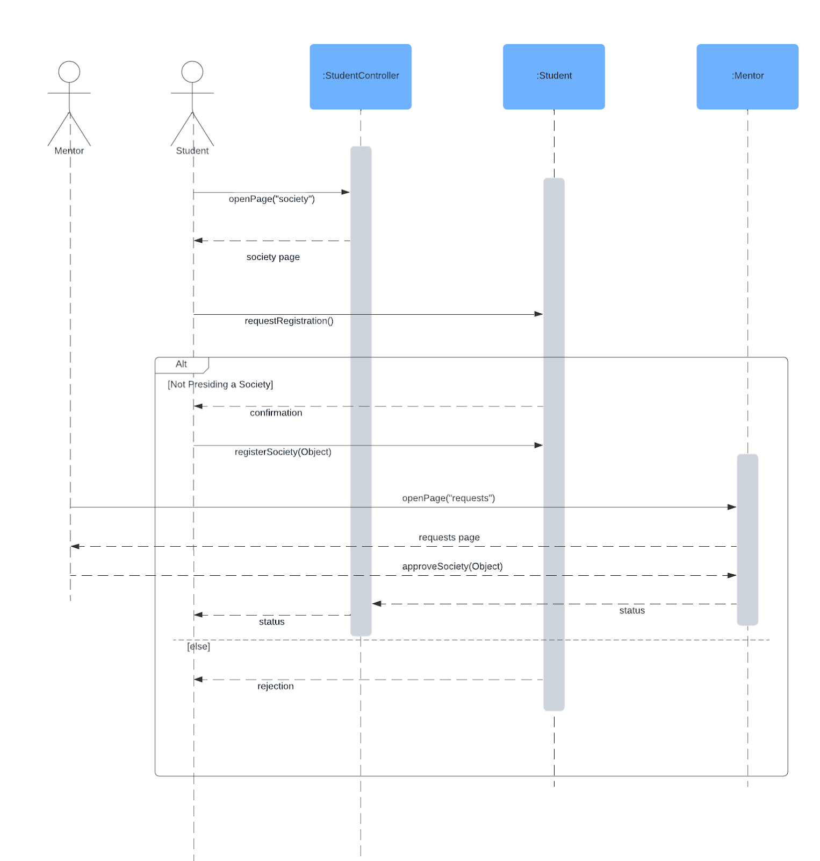
SEQUENCE DIAGRAM:
SOCIETY REGISTRATION
MAIN SOCIETY PAGE FOR MENTOR

Slide 16
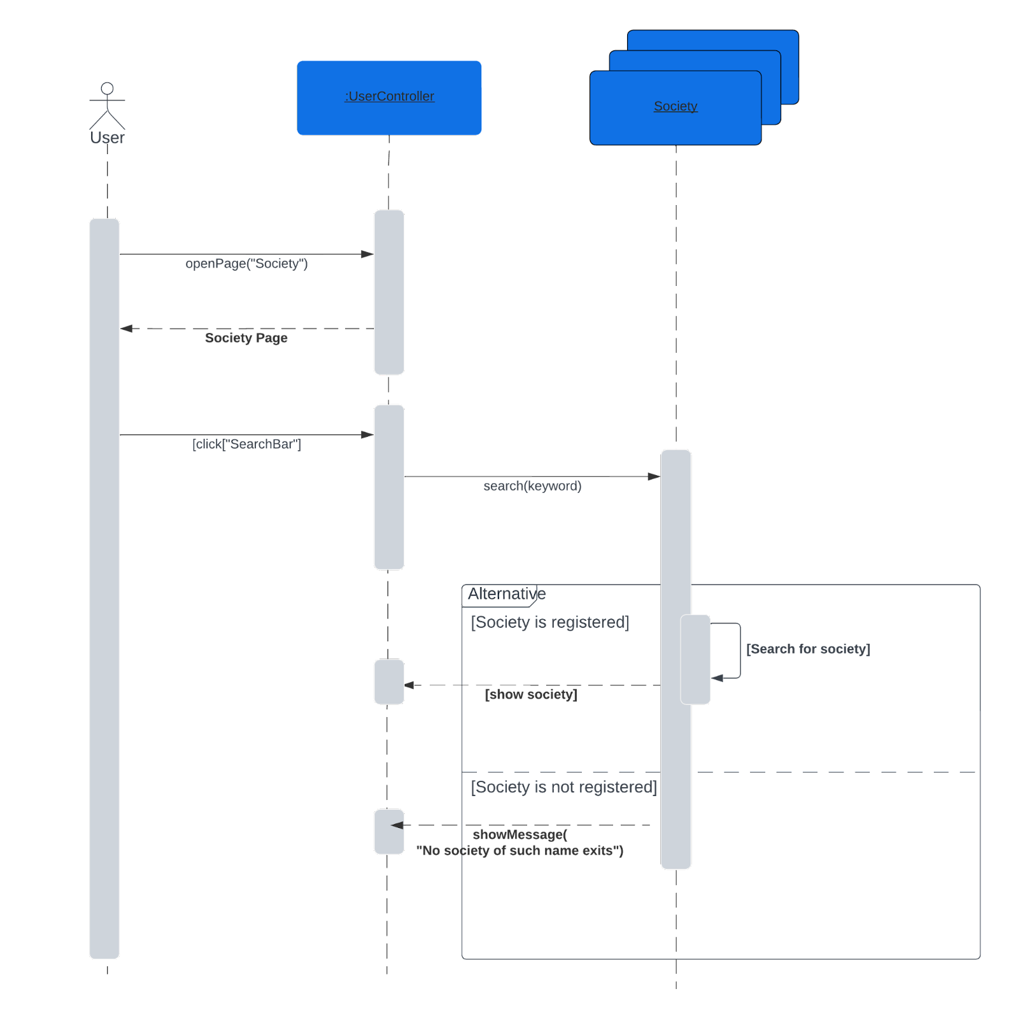
SEQUENCE DIAGRAM: SEARCH SOCIETY
MAIN SOCIETY PAGE FOR MENTOR

Slide 17
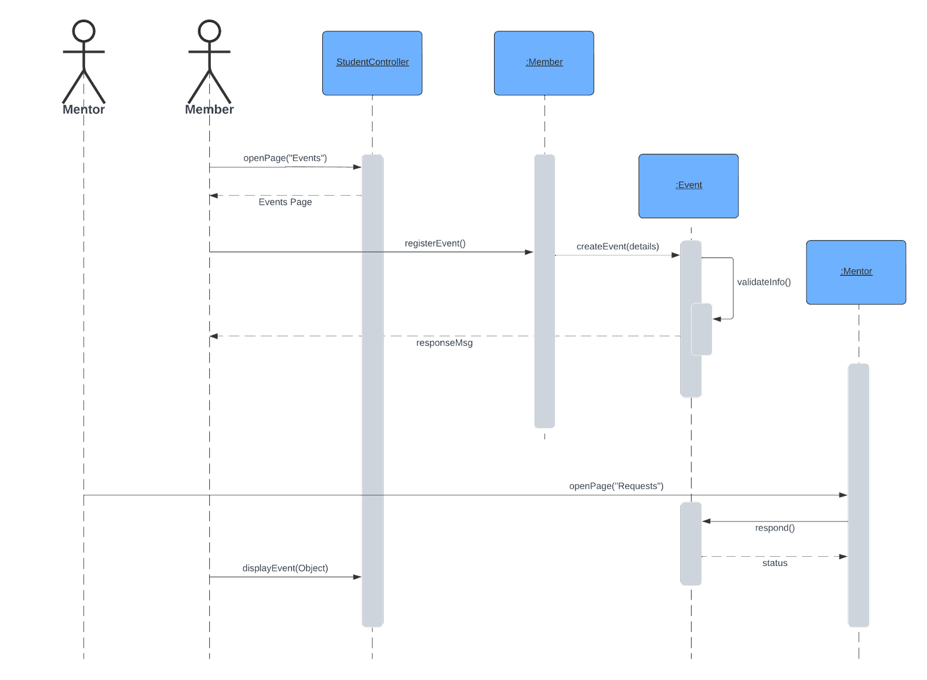
SEQUENCE DIAGRAM: REGISTER EVENT
MAIN SOCIETY PAGE FOR MENTOR

Slide 18
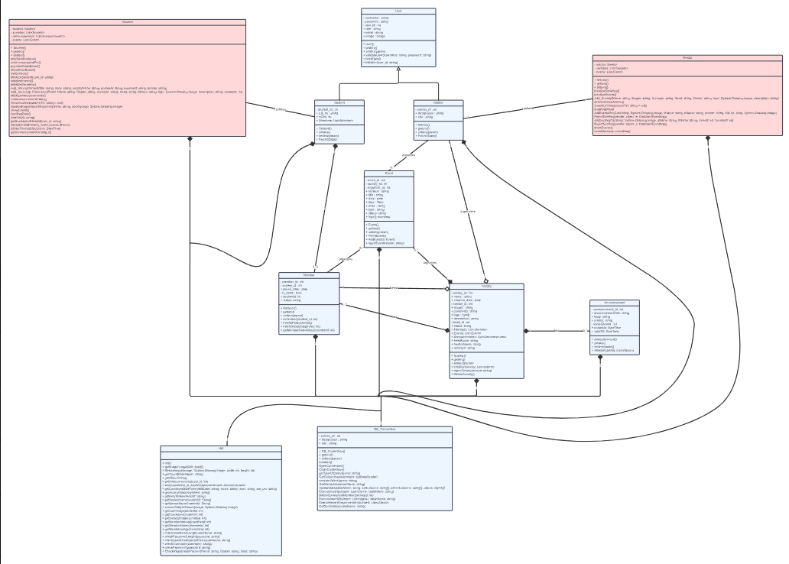
CLASS DIAGRAM
MAIN SOCIETY PAGE FOR MENTOR

Slide 19
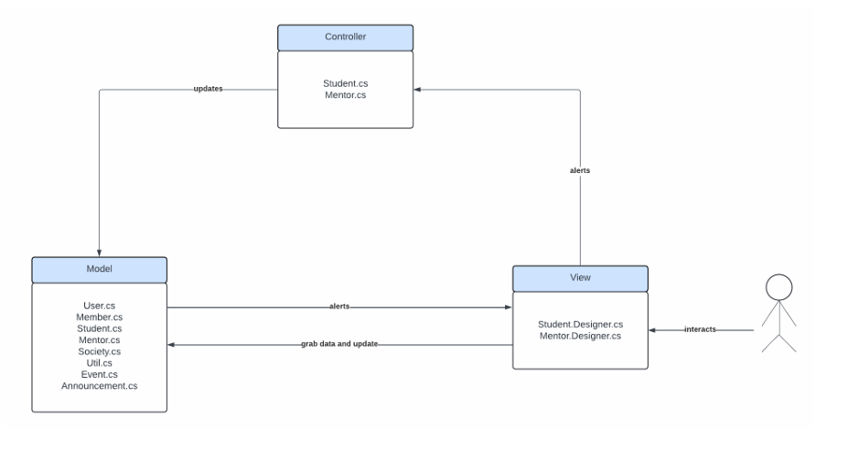
ARCHITECTURE
ARCHITECTURE
LESSON LEARNT
The project is implemented using the Model-View-Controller (MVC) architecture to facilitate the maintainability and efficiency of the application. This pattern helps in segregating the codebase into three layers. This separation ensures that the application is maintainable and scalable.
The primary reason to implement this architecture was to address performance issues. A significant lag was observed after logging in, when only one class per user (student or mentor) was invoked. This bottleneck was solved by introducing the following model classes:-
Announcement | Event | Member | Mentor
Society | Student | User | Utility

Slide 20
IMPLEMENTATION
PART 5.
IMPLEMENTATION
MENTOR
MEMBER
STUDENT

Slide 21
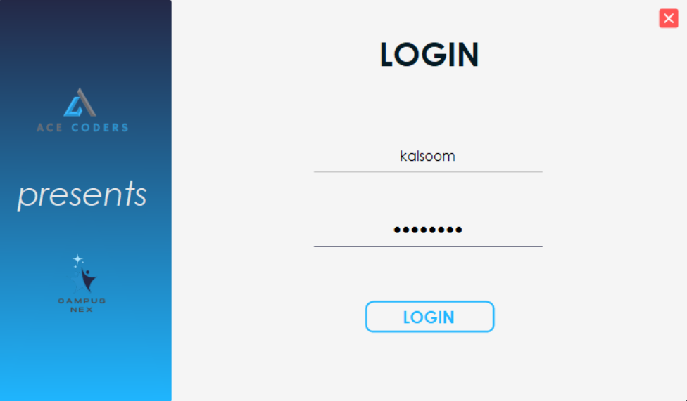
LOGIN
LESSON LEARNT

Slide 22
MAIN FUNCTIONALTIES OF MEMBER/HEAD
ONLY FOR HEAD: Head can view new member requests.
Member can view registered societies and search for any society as well
Member can register new events.
Member can register new societies.
Member can change their credentials through Dashboard
5
4
3
2
1

Slide 23
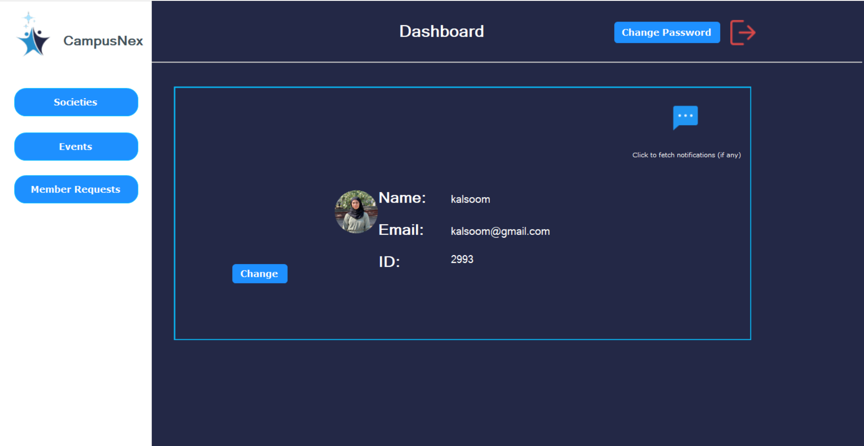
LESSON LEARNT

Slide 24
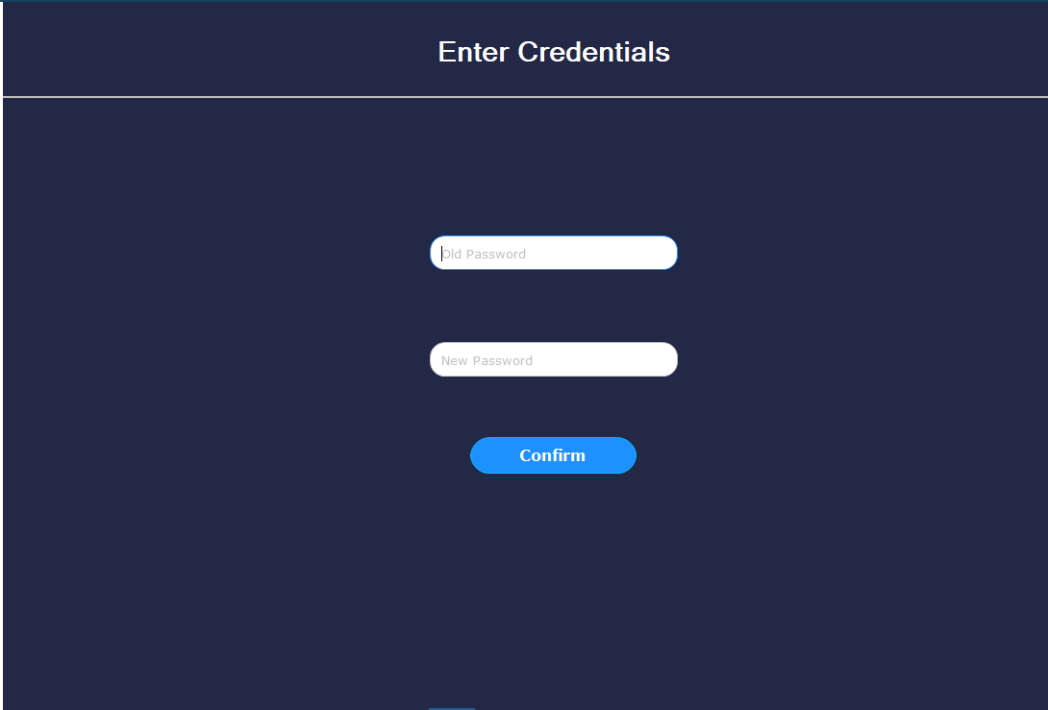
LESSON LEARNT

Slide 25
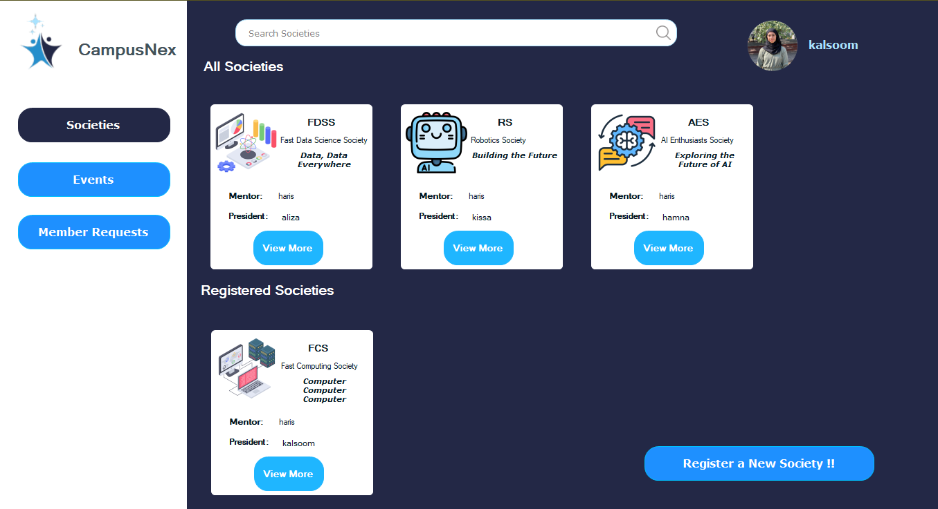
LESSON LEARNT

Slide 26
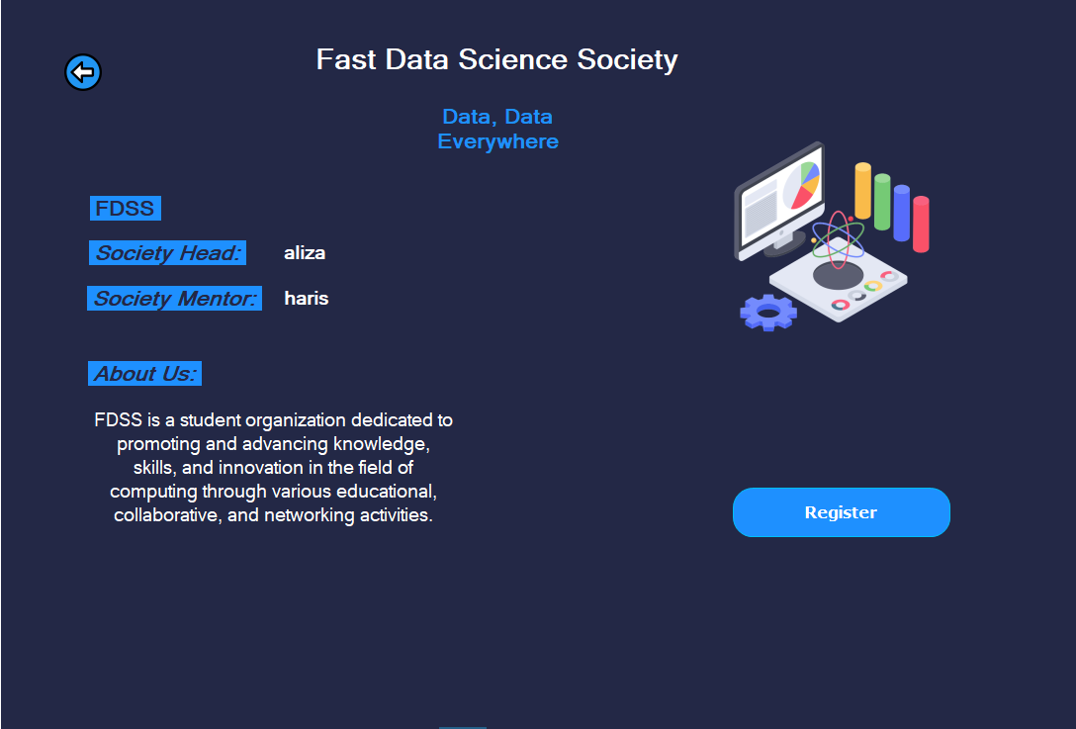
LESSON LEARNT

Slide 27
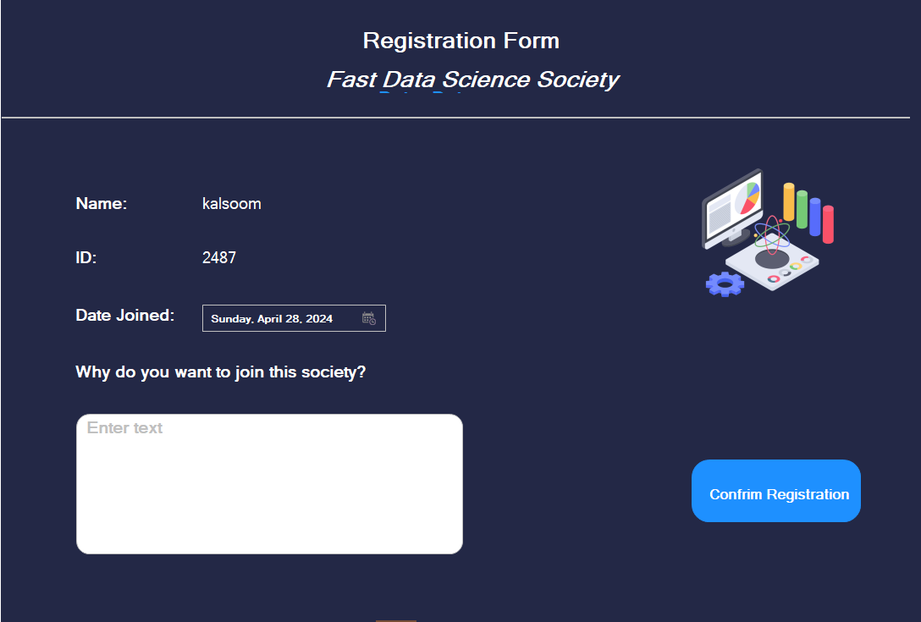
LESSON LEARNT

Slide 28
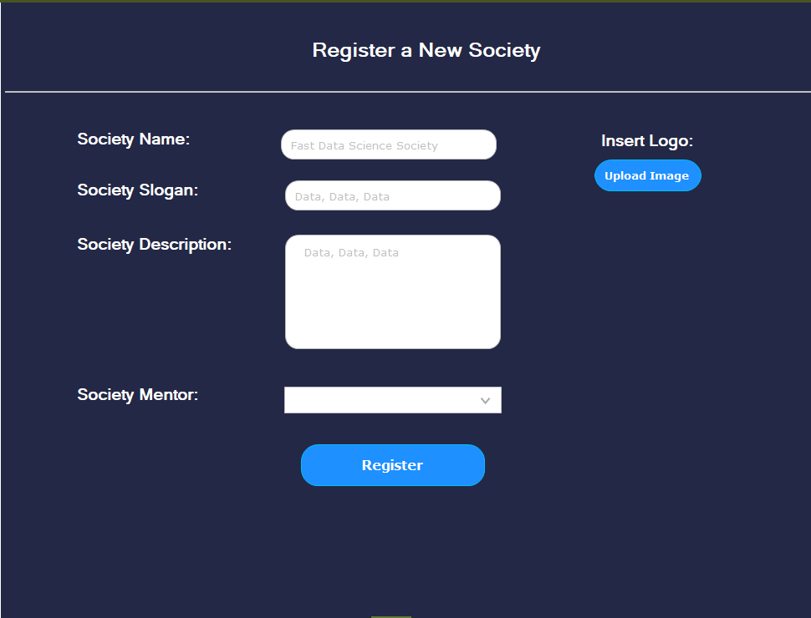
LESSON LEARNT

Slide 29
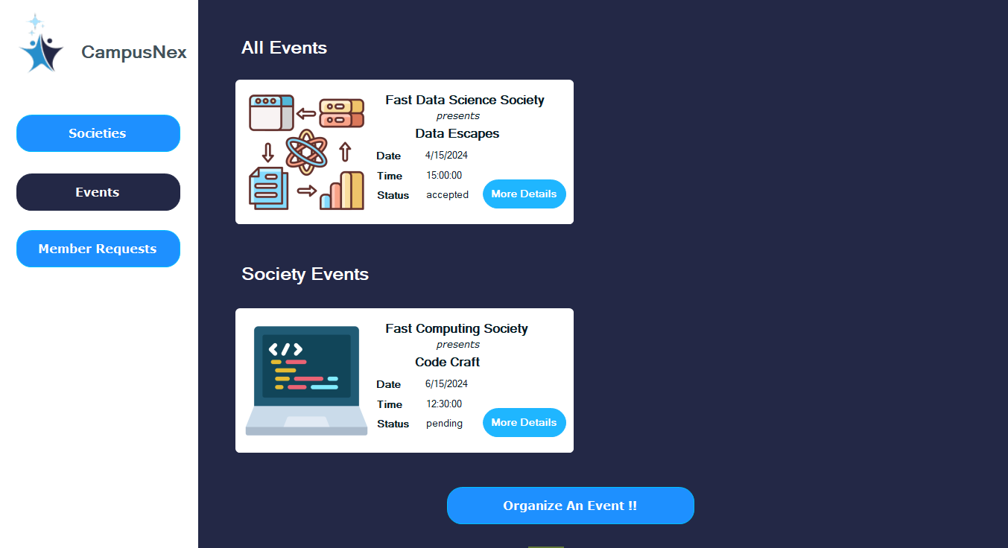
LESSON LEARNT

Slide 30
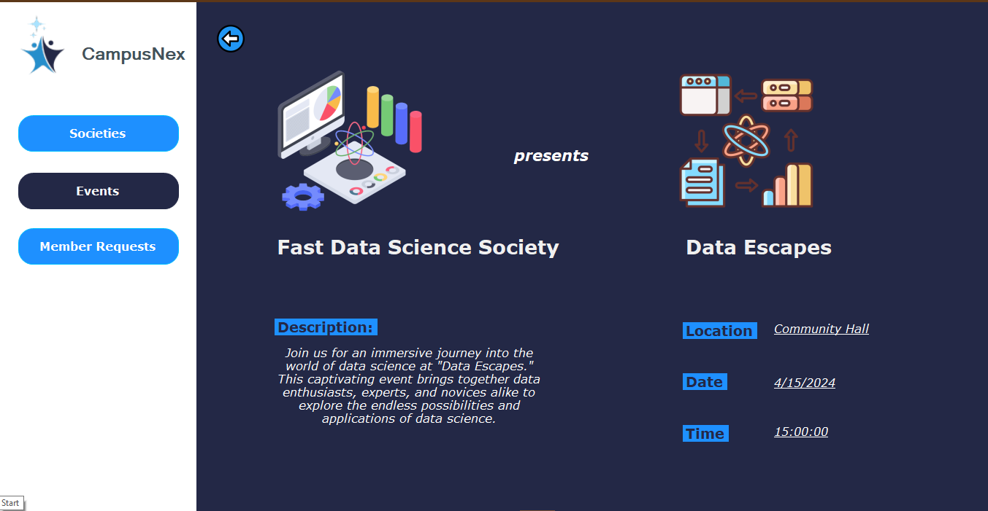
LESSON LEARNT

Slide 31
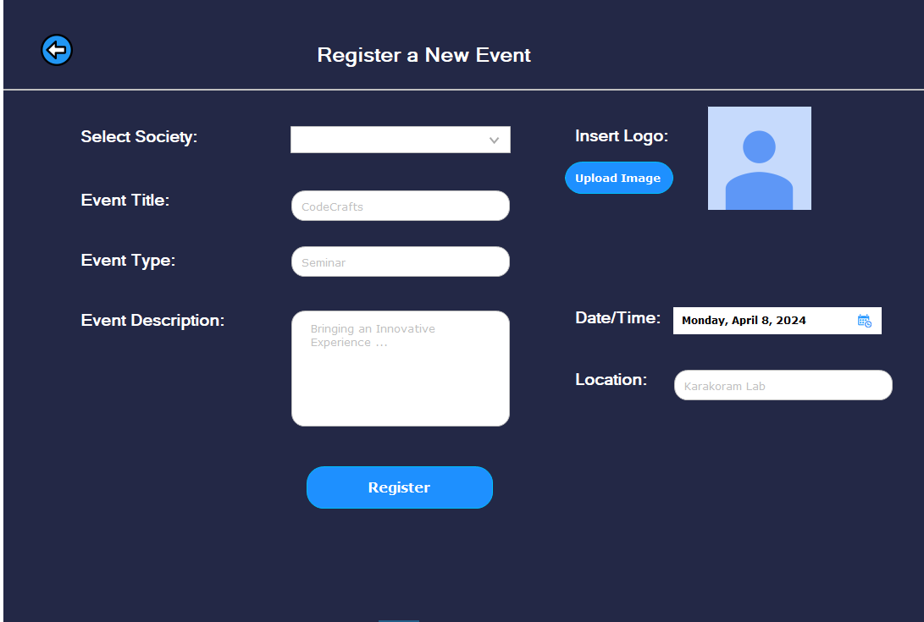
STUDENT :
REGISTER EVENT
LESSON LEARNT

Slide 32
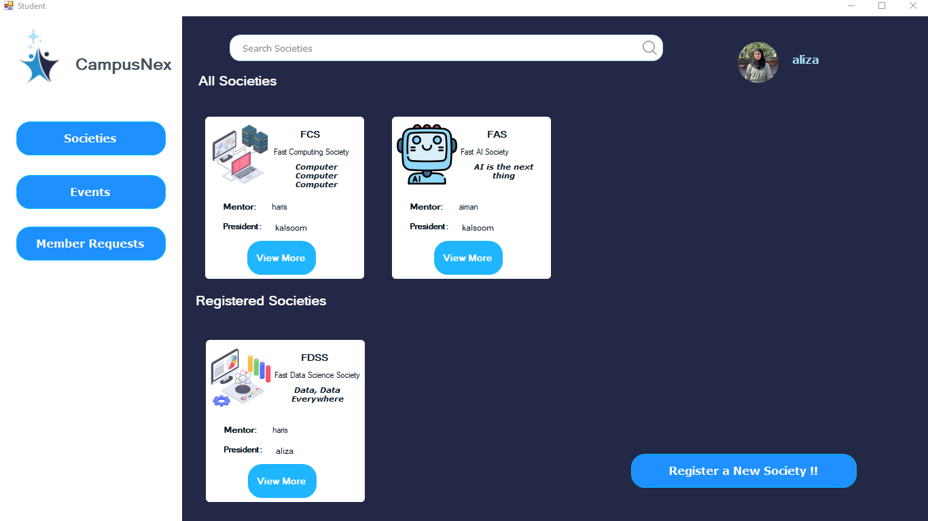
STUDENT :
MEMBER REQUEST
LESSON LEARNT

Slide 33
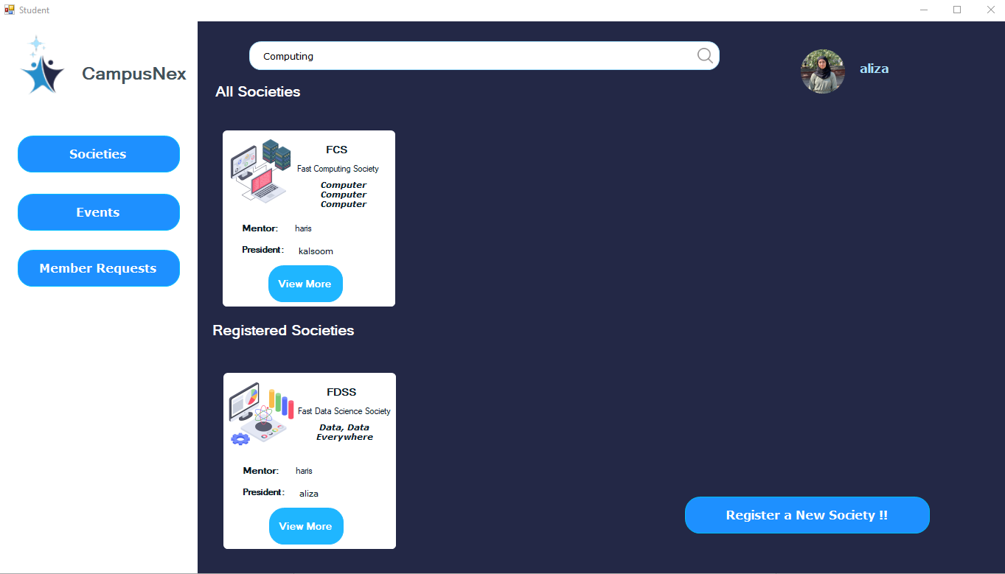
STUDENT :
MEMBER REQUEST
LESSON LEARNT

Slide 34
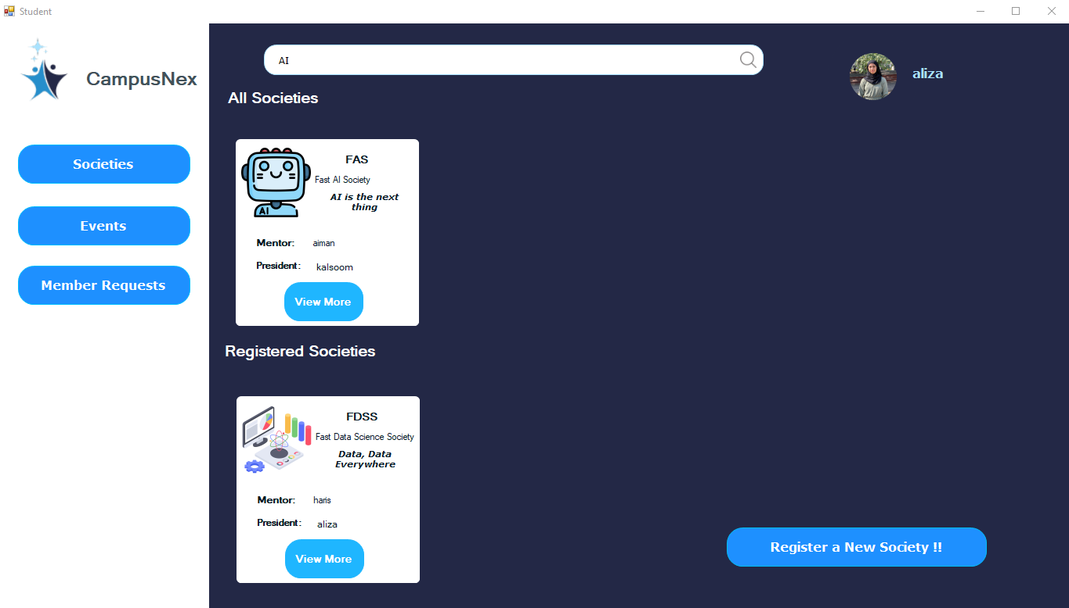
STUDENT :
MEMBER REQUEST
LESSON LEARNT

Slide 35
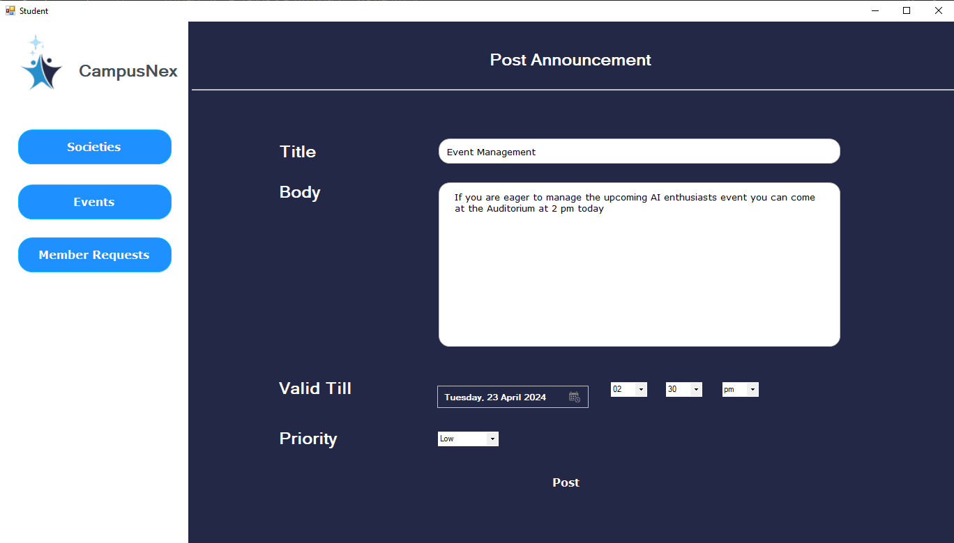
STUDENT :
MEMBER REQUEST
LESSON LEARNT

Slide 36
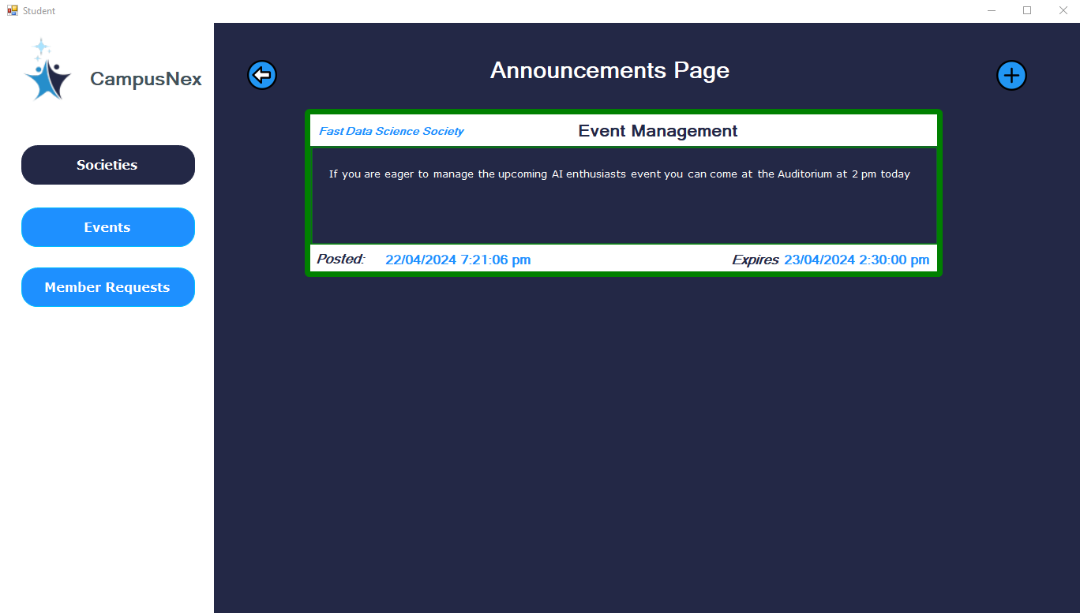
STUDENT :
MEMBER REQUEST
LESSON LEARNT

Slide 37
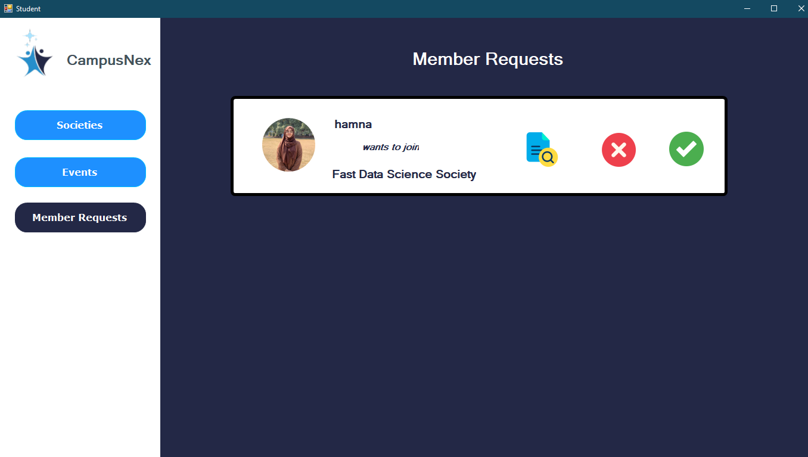
STUDENT :
MEMBER REQUEST
LESSON LEARNT

Slide 38
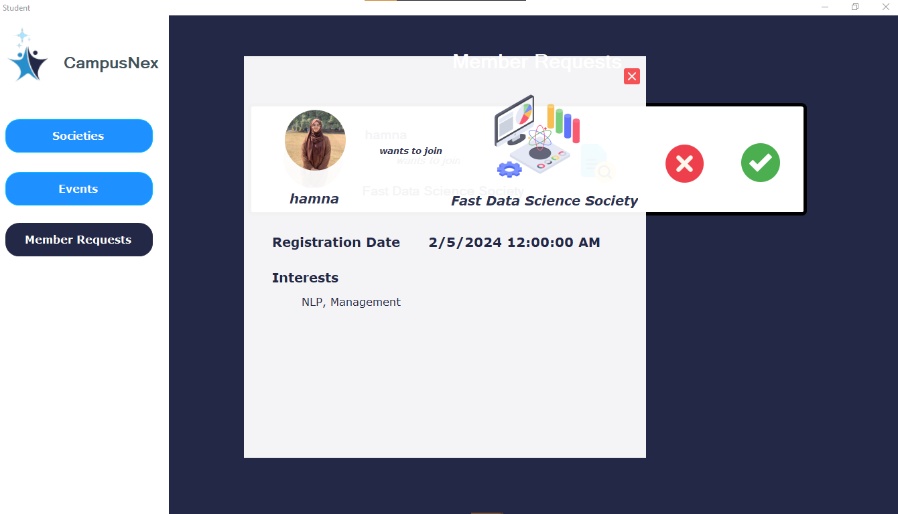
STUDENT :
MEMBER REQUEST
LESSON LEARNT

Slide 39
MENTOR MAIN FUNCTIONALTIES
View more about registered Societies.
1
Can view upcoming events and view details about a particular society.
2
Can view more details, accept and reject new society requests.
3
Can view more details, accept and reject event requests.
4
5

Slide 40
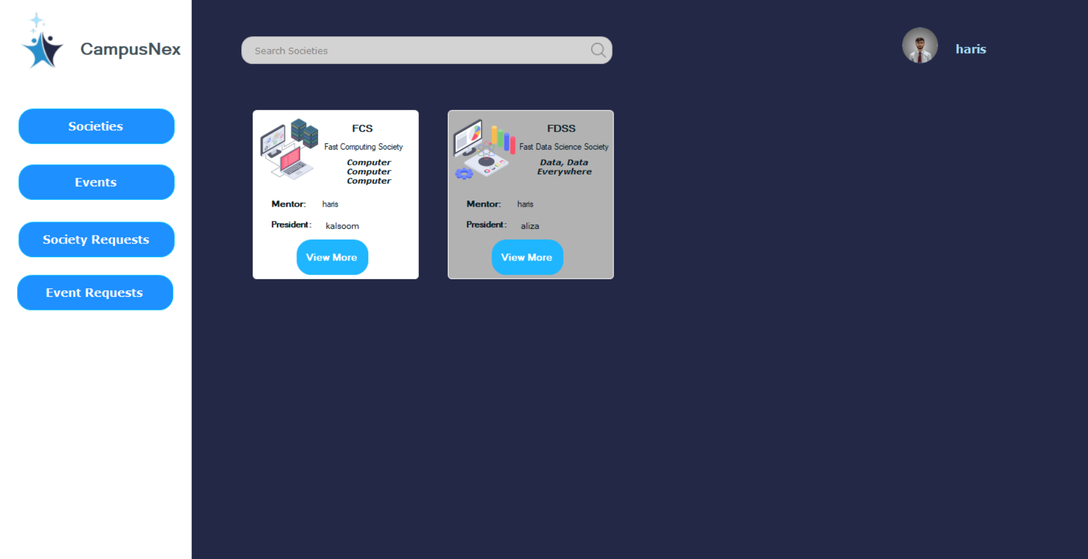
LESSON LEARNT

Slide 41
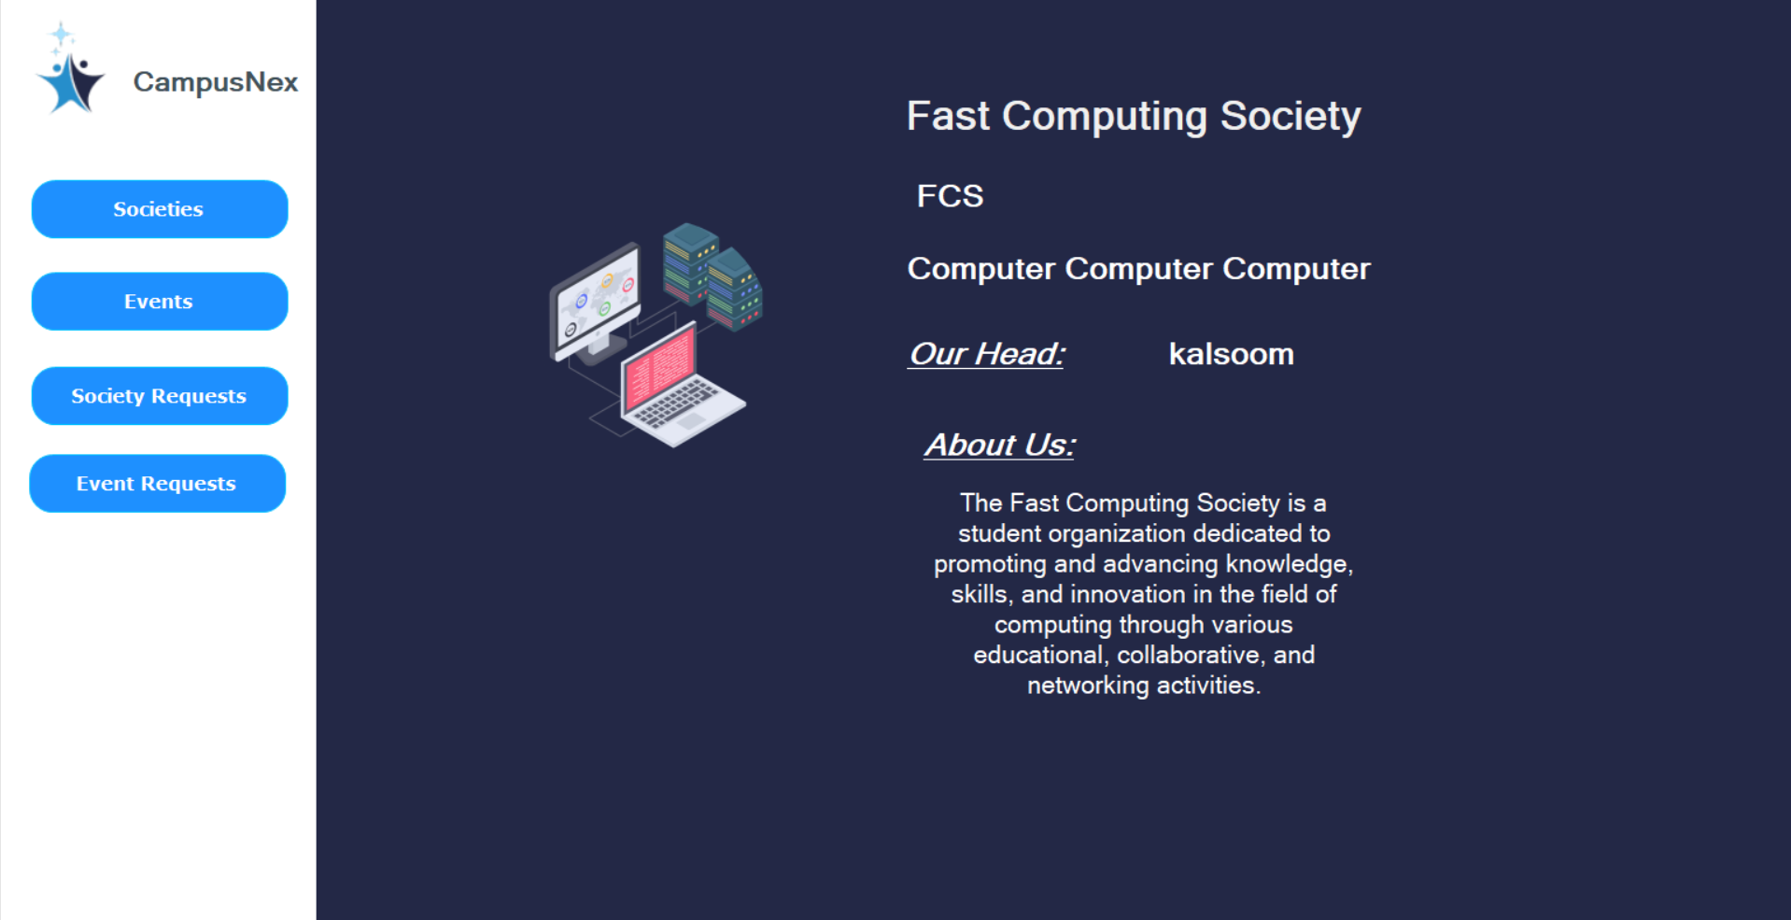
MENTOR :
VIEW MORE SOCIETY
LESSON LEARNT

Slide 42
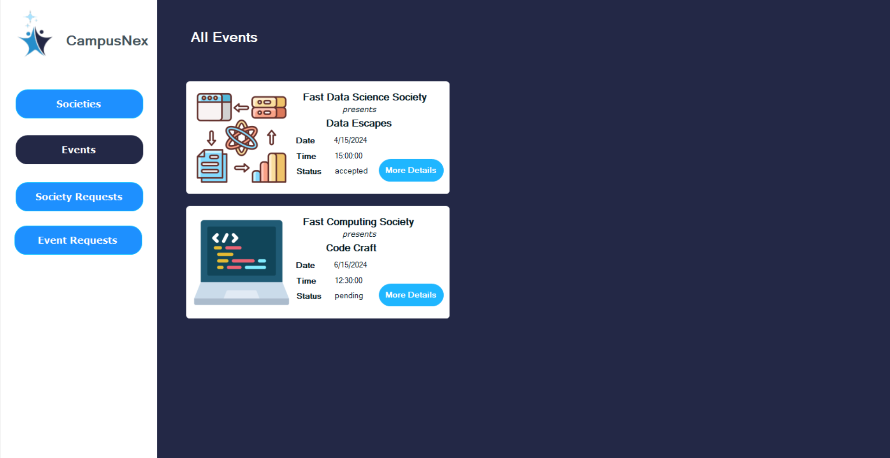
LESSON LEARNT

Slide 43
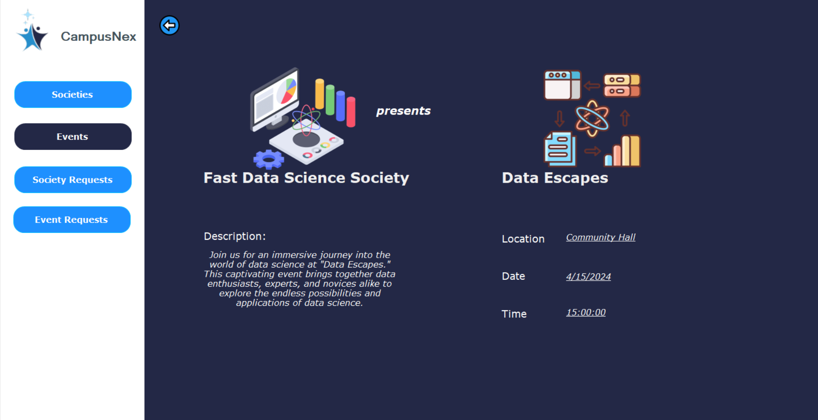
MENTOR :
VIEW EVENT
LESSON LEARNT

Slide 44
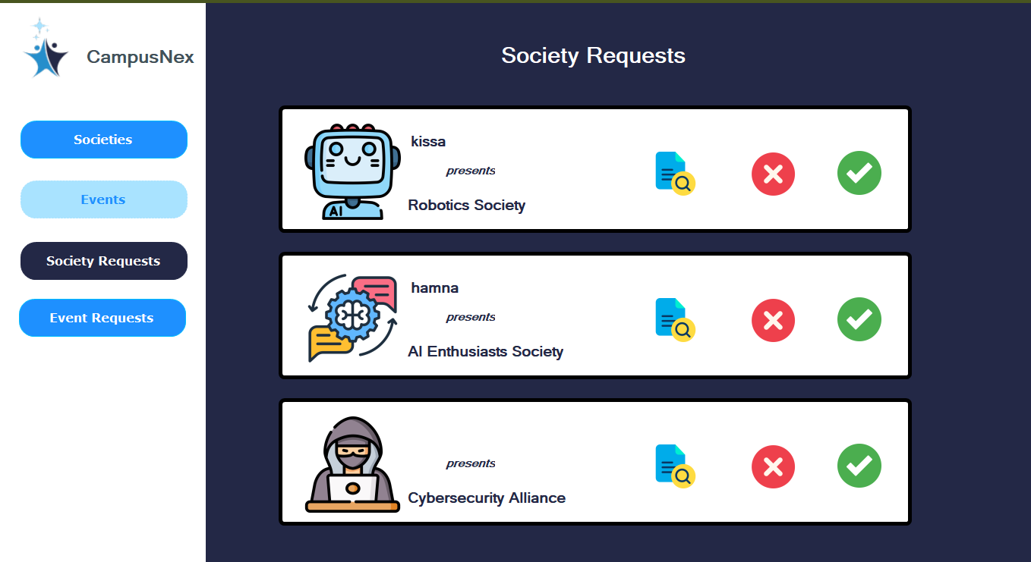
MENTOR :
SOCIETY REQUESTS
LESSON LEARNT

Slide 45
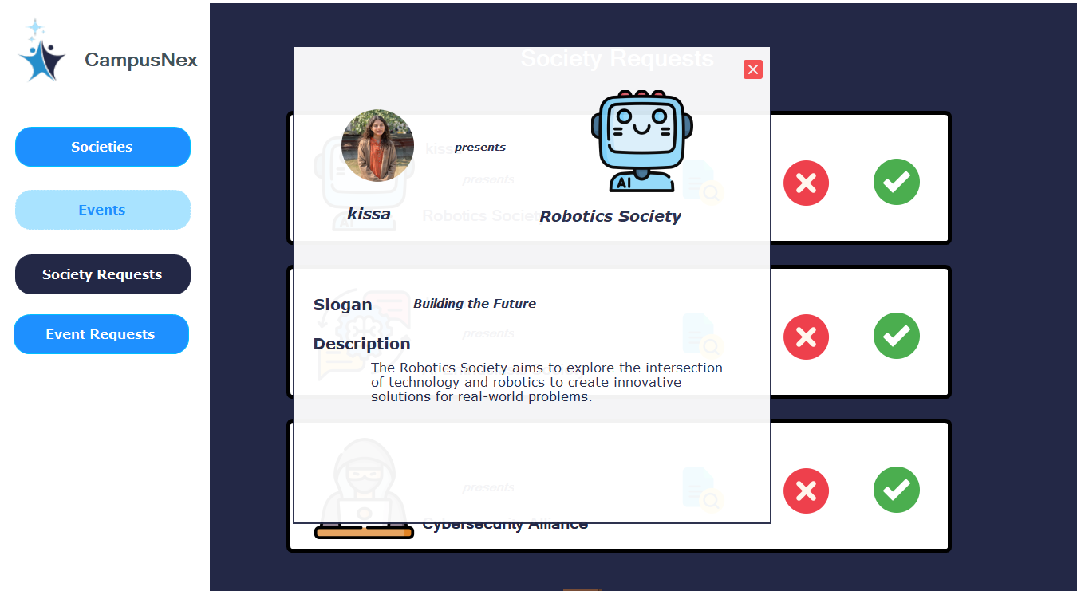
LESSON LEARNT

Slide 46
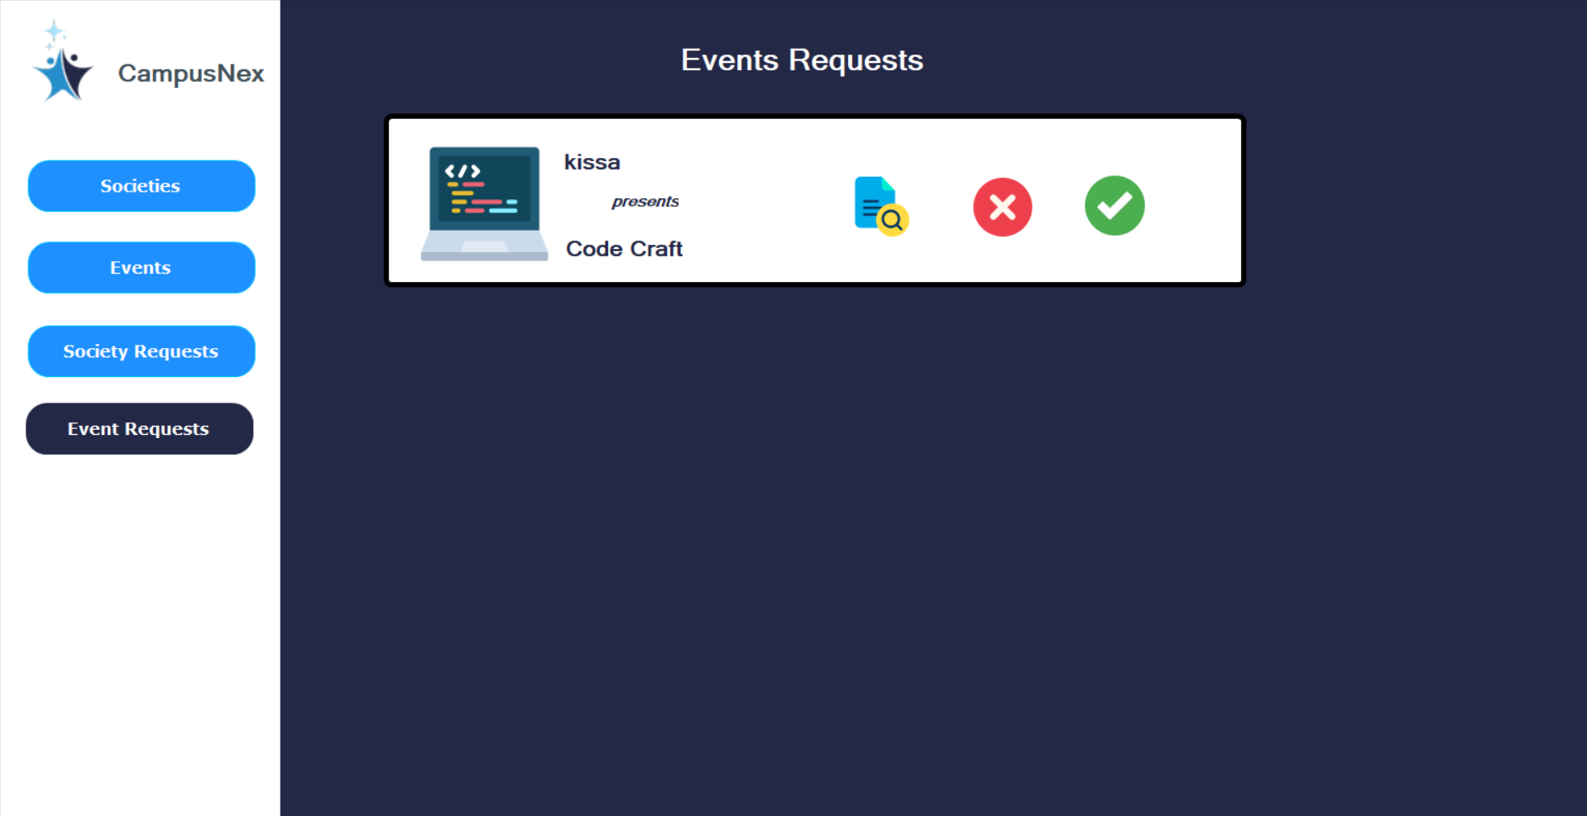
LESSON LEARNT

Slide 47
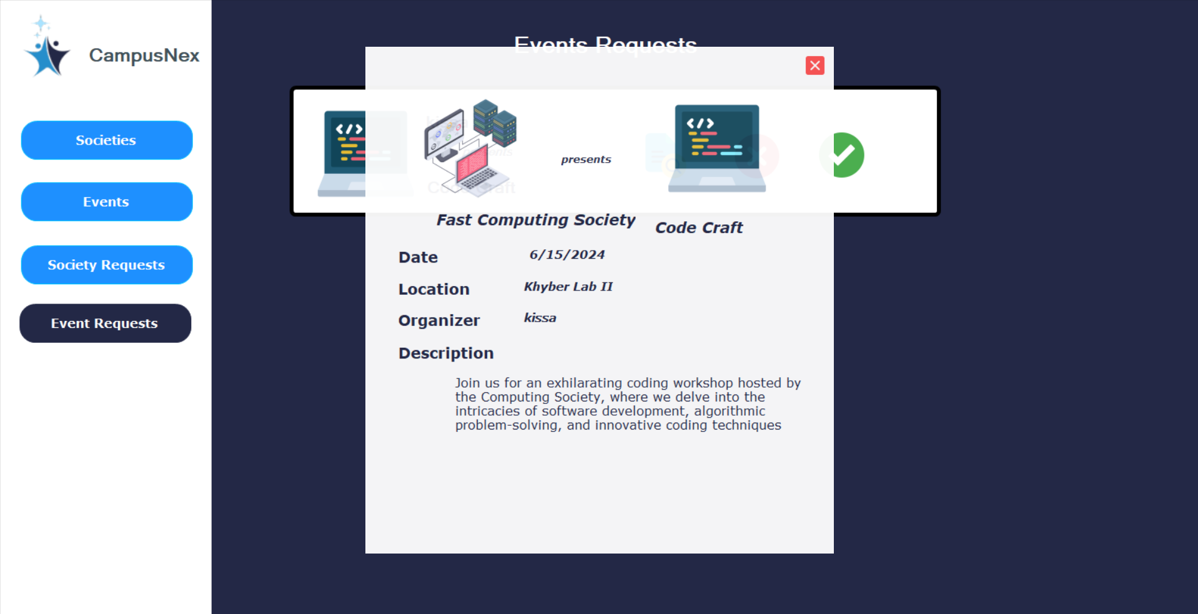
LESSON LEARNT

Slide 48

WORK DIVISION
PART 6.
WORK DIVISION
ITERATION 0
ITERATION 1
ITERATION 2
ITERATION 3

Slide 49




WORK DIVISION
ITERATION 1
AIMEN SAFDAR
HARIS SOHAIL
KALSOOM TARIQ
User Story 02
Structured Specification 02
Document Compilation
NFR01
Module 01 Introduction
Database ERD
User Story 01
Structured Specification 01
Implementation Setup
NFR02+03
Database ERD
User Story 03
Structured Specification 03
Scrum Board Design
Burndown Chart
NFR04
Database ERD and
Schema

Slide 50
WORK DIVISION
ITERATION 2
AIMEN SAFDAR
HARIS SOHAIL
KALSOOM TARIQ
Sub Story 1.1+3.1
Structured Specification 1.1+3.1
Activity Diagram 02
Sequence Diagram 02
Document Design
Use Case Diagram
Class Diagram
View Society Page
User Story 4
Structured Specification 4
Activity Diagram 01
Sequence Diagram 01
Module Introduction
Use Case Diagram
Class Diagram
System Architecture
Search Society
User Story 5
Structured Specification 5
Activity Diagram 03
Sequence Diagram 03
Use Case Diagram
Class Diagram
Member Registration
Event Registration

Slide 51
WORK DIVISION
ITERATION 3
AIMEN SAFDAR
HARIS SOHAIL
KALSOOM TARIQ
Architecture
Lesson Learnt
Test Cases of Login and Registration
Post Announcements
Search Societies
Login Page BVA
Lesson Learnt
Document Compilation
Project Introduction
Project Burndown Chart
Society Page Update
View Society Request
Society Registration BVA
Lesson Learnt
Presentation
View Member Request
View Event Detail

Slide 52
LESSON LEARNT
PART 7.
LESSON LEARNT
KALSOOM TARIQ
HAIRS SOHAIL
AIMEN SAFDAR

Slide 53
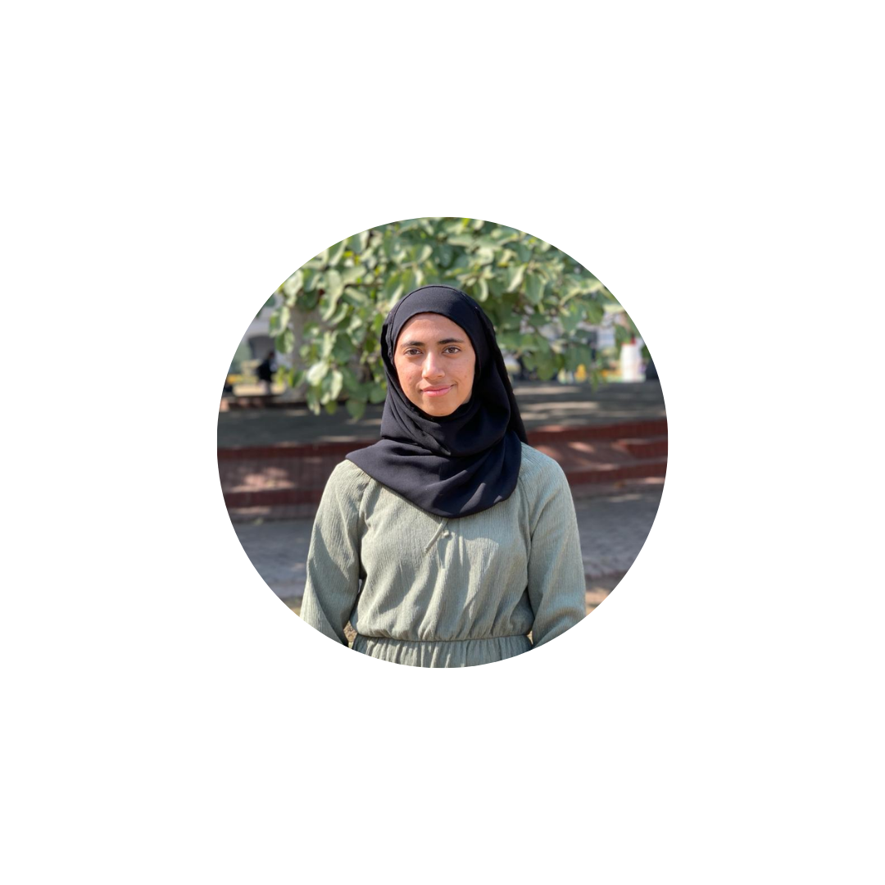

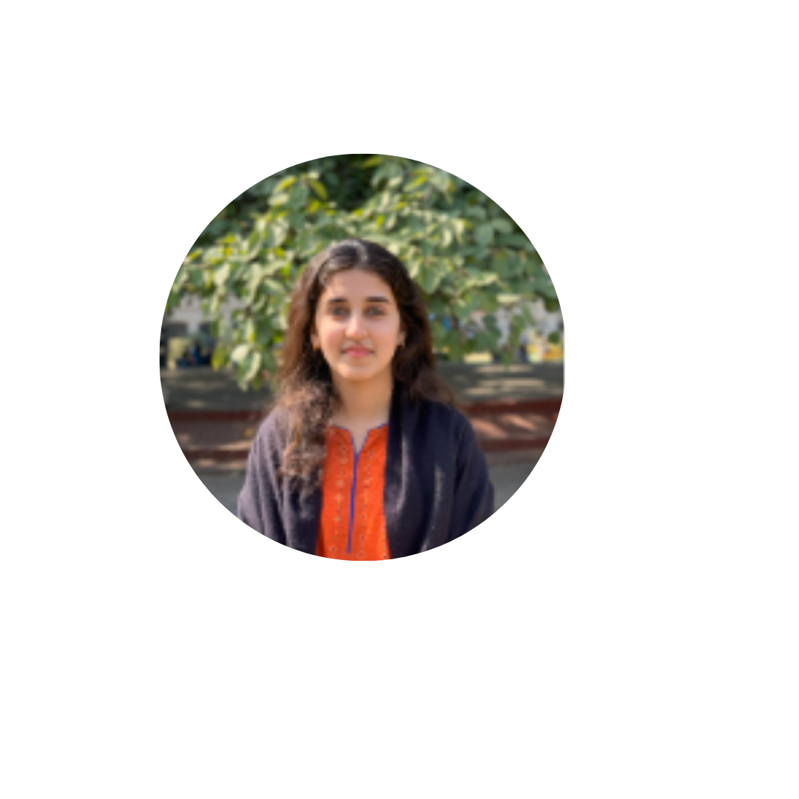


LESSON LEARNT
KALSOOM TARIQ
HARIS SOHAIL
AIMEN SAFDAR
This has been, by far, the best group project I have had during all my semesters. And the credit goes to Sir Bilal Khalid Dar and my supportive group members.
Throughout this project, not only did I learn technical skills like WinForms’s user controls and collaboration over github but also polished my teamwork and project management skills.
Debugging unique problems that resulted from working with so many technologies like Visual Studio, Github and Sql Management Server concurrently was something that I found challenging in this project.
This project has greatly enhanced my collaborative, technical and discipline skills. Moreover, I have learned many management skills from our group leader Kalsoom.
I feel proud of the progress we have made throughout this project. The determination and consistency of the entire team has made me realize the importance of consistent hard work.
As compared to other projects, we have faced significantly less challenges. In my opinion, this is because of the transparency of work between every individual, and great knowledge about the scope and implementation of the project. Any other challenges, however, were easily solved in our regular meetings.
I am forever more grateful for my group members for the laughs as well as the passion they showed towards this project that gave me the motivation to push myself.
This project aided in understanding WinForms and its technicalities better, and how crucial GitHub is for collaborative projects like this. Additionally, I saw an improvement in my debugging and time management skills; so not only did I gain knowledge in terms of using different software, but I also grew as a person.

